Slide 1



PROJECT PRESENTATION
Project Title: ERP(Controller of Examination)
Guided By:
Ms. Neha Shukla Mam
Presented By:
Avinash Kumar (2000290120050 )
Varun Kumar Tiwari (2000290120186)
Notes:
<number>

Slide 2

CONTENT
Problem Statement.……………………..……..........................................1
Objectives………………………………………........................................2
Technology Used…………………………………...............................….3
Work Flow Diagram…………….…………………...................................4
Project Status..........................……………..............................................5
Implementation Details…………….…………………………….……......6-7
End User………...………………………………………………………....8
Advantage……………………………………………................................9
Summary…………………………………………………………………...10
Expected Outcomes....................................................................................11

Slide 3
Problem Statement
Examination Cell was facing issue in the generation of Datesheet ,Seating Plan, Invigilation Duty Chart and Attendance .
They had to do a lot of manual work before the conduction of every examination.
They had to prepare different type reports for sending the information to student and faculty.
They had to prepare list of attendance manually to send the respective HOD's and higher authority.
The management of data was also a difficult task for them. So they provided us the idea to implement the process of examination.
We gathered the complete information from them regarding the process of examination and analyzed the requirement before implementation.

Slide 4
Objectives
Generation of Datesheet.
Generation of Seating Plan.
Generation of Invigilation Duty Chart.
Attendance of students appearing for examination.
Different types of reports.

Slide 5
Technology Used
SOFTWARE REQUIREMENTS
Operating system: Windows, Linux
Coding Language: Python, HTML, CSS, JavaScript
Frameworks: Django, Angular JS, React JS
Database: MySQL

Slide 6
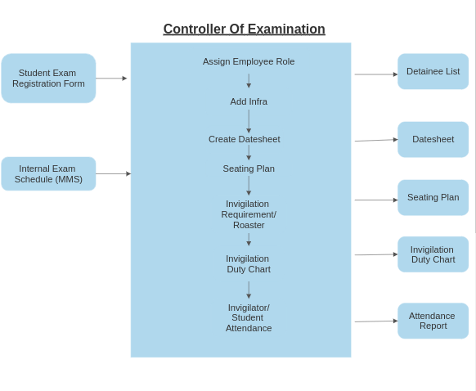
Work Flow Diagram

Slide 7
Project Status
This module has been approximately 95% developed, and all the completed portions have undergone thorough testing using various real-time test cases. The components comprising the Datesheet, Seating Plan, Invigilation Duty Chart, as well as student and faculty attendance, have been successfully developed and rigorously tested. Over the past two semesters, our college's examination team has utilized this module for conducting all examinations.
Additionally, discussions are underway for new requirements, and work is currently in progress for their implementation.

Slide 8
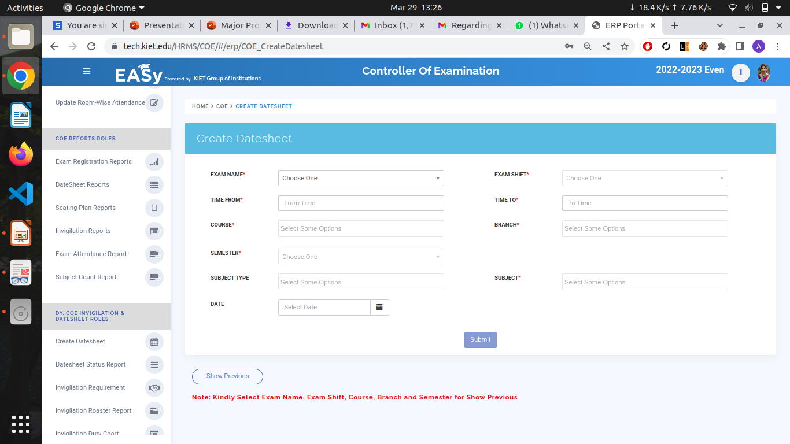
IMPLEMENTATION

Slide 9
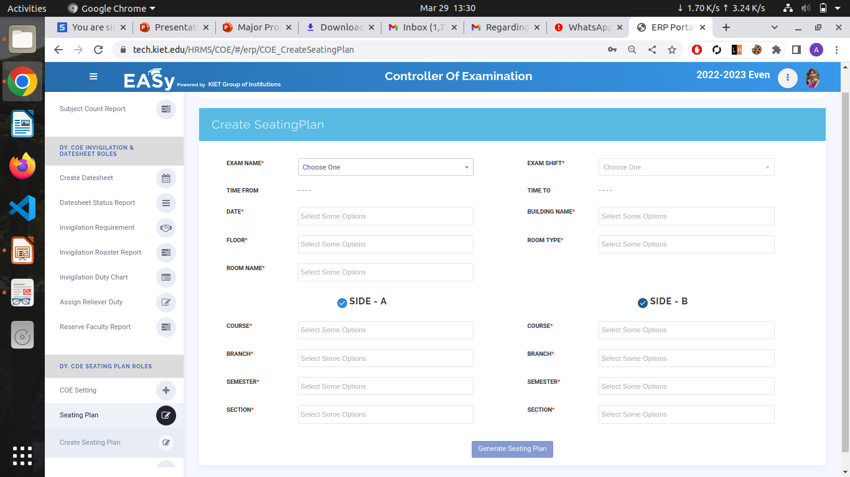

Slide 10
END USER
OUR END USERS ARE:-
Faculty
Students
Stake Holders

Slide 11
Advantages
It has decreases the manual work.
It has increases the speed of work.
It has made the process paperless.
It has made the process easy .
It has decreases the manual error like student with same subject sometime seat together in the seating arrangement during the examination.

Slide 12
SUMMARY
We have created the web-based application that process all the procedure of examination system. It has automated the process of Datesheet generation, seating plan , Invigilator Roaster, Invigilation duty chart.On the basis of rules provided by the stake holder we have used all of them for the automation of the process. It has decreased the manual work. It has various reports that are required for the stake holders. It has made the work of the Examination Cell easy and it has also made the storage and access of data easy. From the data of the COE Module we have made the hall ticket for students that provide them details of subject and seating plan for every exam that is scheduled for them on Student Portal.

Slide 13
THANK YOU

